Slide 1
Sequential Circuits’ design

Slide 2
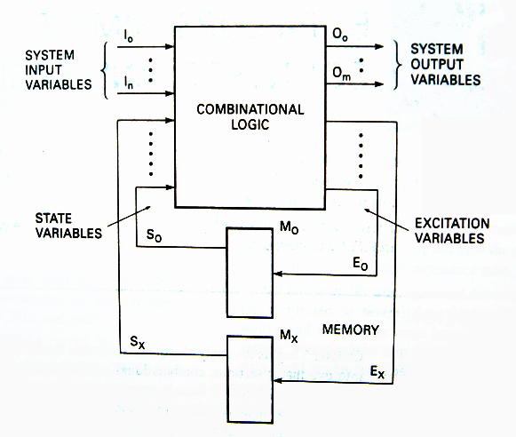
Input variable
Output variable
State variable
Excitation variable
State
State variables and states are related by the expression:
2^{x}=y
State variables
states
Notes:
与组合逻辑电路相比，也就是多了状态变量，和激励变量。

Slide 3
State Diagram 状态图
State Diagram: Graphical representation of a state table.
Graph node with label s denotes state s
Graph edge with label X denotes transition between two states when input X is applied
S
The state diagram of D flipflop
X
D=1
D=1
D=0
0
1
D=0

Slide 4
State Diagram of Mealy model
0/0
1/0
I/O
00
01
S1
S2
0/1
Reads as: When at state s1 and apply input I, we get output O and proceed to state s2.
0/1
0/1
1/0
10
1/0
11
1/0
Notes:
当现态为S1，输入I，则机器将转换到状态S2，输出O。

Slide 5
State Diagram of Moore model
I
00,11
S1/O1
S2/O2
01,10
0/0
1/1
Reads as: When at state s1 with output
O1 and apply input I,
we proceed to state s2 with
Output O2.
01,10
00,11

Slide 6
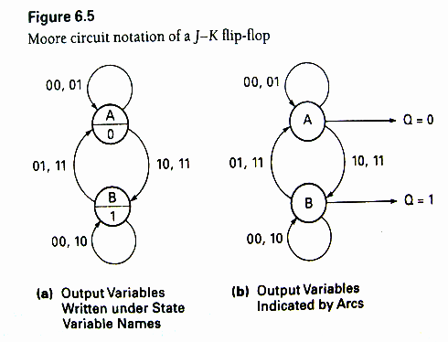
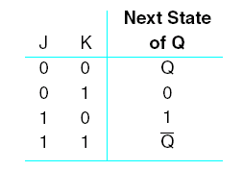
State Diagram
Notes:
J-K触发器的两种Moore电路表示法
(a)输出变量写在状态变量名的下面
(b)用弧线表示的输出变量

Slide 7
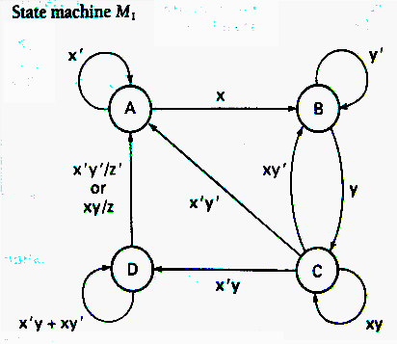
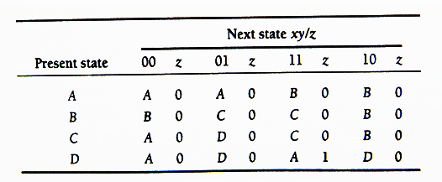
State Table 状态表
Enumerates the relationship between inputs, outputs, and states of the sequential circuit.
Notes:
状态图的表状形式。列出了时序电路的输入、输出以及状态之间的关系。
右上角图中，只指出了z为真的情况

Slide 8
State Table
Notes:
状态和触发器之间如何关联起来？通过状态转换表
先使用状态表的好处？设计完状态流程以前，并不能确定需要几个触发器。

Slide 9
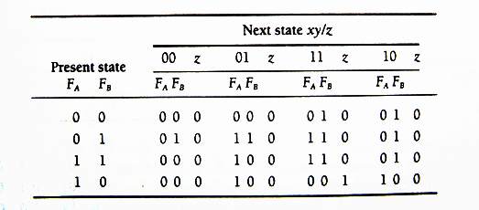

Transition Table 状态转换表
Each state is assigned a unique code.
$$2^{2}=4$$
F_{A} | F_{B} | State
0 | 0 | A
0 | 1 | B
1 | 1 | C
1 | 0 | D
4 state needs 2 state variables
Notes:
将特定的状态变量值分配给每一状态。
此处四个状态，2²=4，需要2个触发器。

Slide 10
Transition Table
Transition Table for state machine M₁
Notes:
左表和右表为等价形式

Slide 11
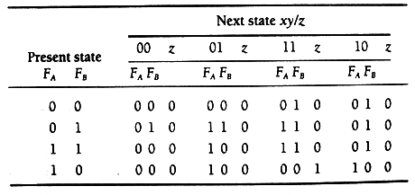
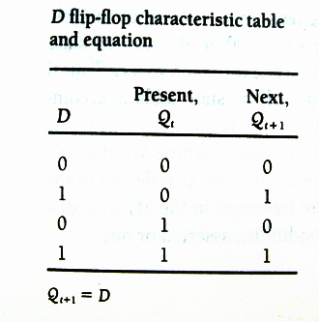
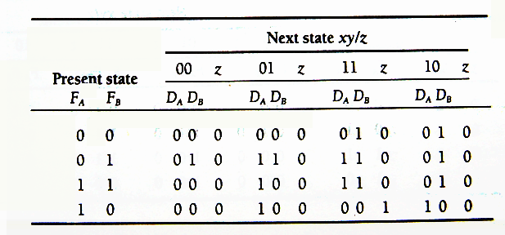
Excitation Table and Equations
Transition Table for state machine M1
D flip-flop used to realize circuit (two D flip-flops)
state machine M1 excitation table using D flip-flops

Slide 12
Excitation Table and Equations
D flip-flop used to realize circuit (two D flip-flops)
How to derive Equations?
D_{A}
D_{B}
Z

Slide 13
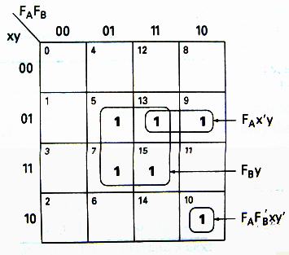
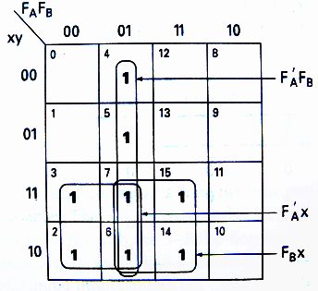
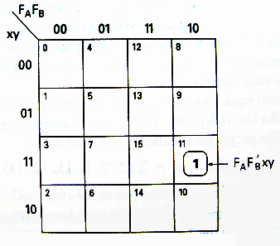
Excitation Table and Equations
D_{A} K-Map
D_{B} K-Map
Z K-Map
D_{A}=f(F_{A},F_{B},x,y)=Σ(5,7,10,13,15)=F_{A}F_{B}’xy’+F_{A}x’y+F_{B}y
D_{B}=f(F_{A},F_{B},x,y)=Σ(2,3,4,5,6,7,14,15)=F_{A}’F_{B}+F_{A}’x+F_{B}x
Z= f(F_{A},F_{B},x,y)=Σ(11)=F_{A}F_{B}’xy

Slide 14
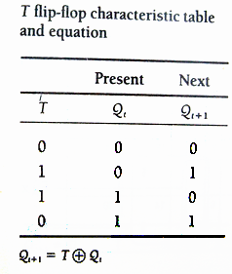
Excitation Table and Equations
Transition Table for state machine M₁
T flip-flop used to realize circuit (two T flip-flops)

Slide 15
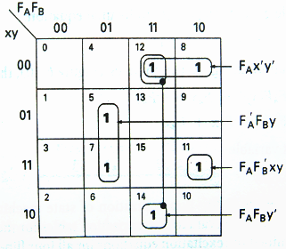
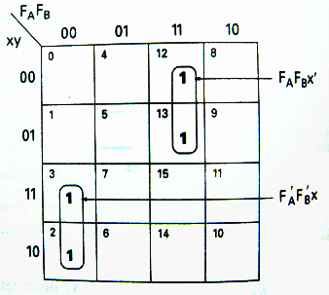
Excitation Table and Equations
T_{A} K-Map
T_{B} K-Map
T_{A}=f(F_{A},F_{B},x,y)=Σ(5,7,8,11,12,14)=F_{A}F_{B}’xy+F_{A}x’y’+F_{A}F_{B}y’+F_{A}’F_{B}y
T_{B}=f(F_{A},F_{B},x,y)=Σ(2,3,12,13)=F_{A}’F_{B}’x+F_{A}F_{B}x’

Slide 16
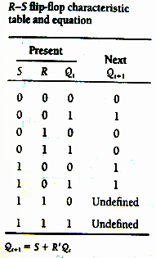
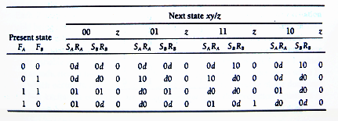
Excitation Table and Equations
Transition Table for state machine M₁
S-R flip-flop used to realize circuit (two SR flip-flops)
state machine M1 excitation table using S-R flip-flops

Slide 17
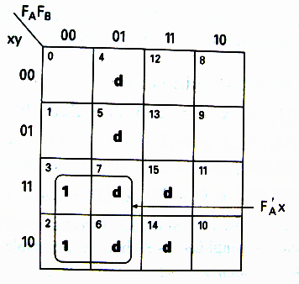
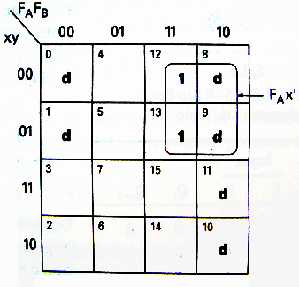
Excitation Table and Equations
S_{A} K-Map
R_{A} K-Map
S_{B} K-Map
R_{B} K-Map
S_{A}=f(F_{A},F_{B},x,y)=Σ(5,7) +Σd(9,10,13,15) =F_{B}y
R_{A}=f(F_{A},F_{B},x,y)=Σ(8,11,12,14) +Σd(0,1,2,3,4,6) =F_{B}’xy+x’y’+F_{B}y’
S_{B}=f(F_{A},F_{B},x,y)=Σ(2,3) +Σd(4,5,6,7,14,15) =F_{A}’x
R_{B}=f(F_{A},F_{B},x,y)=Σ(12,13) +Σd(0,1,8,9,10,11) =F_{A}x’

Slide 18
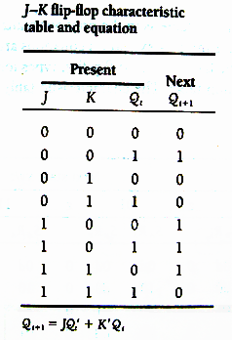
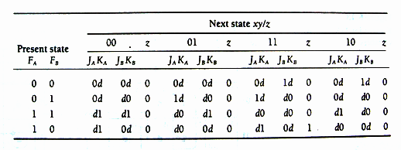
Excitation Table and Equations
Transition Table for state machine M₁

Slide 19
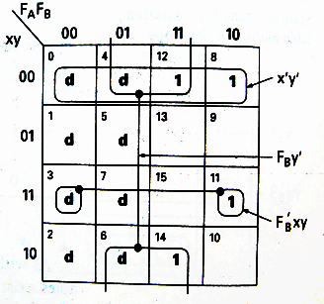
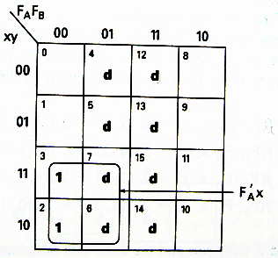
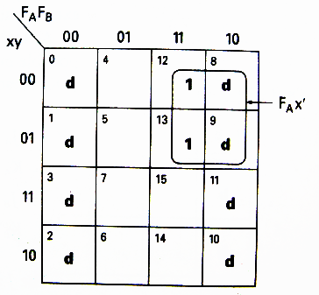
Excitation Table and Equations
J_{A} K-Map
K_{A} K-Map
J_{B} K-Map
K_{B} K-Map
J_{A}=f(F_{A},F_{B},x,y)=Σ(5,7) +Σd(8,9,10,11,12,13,14,15) =F_{B}y
K_{A}=f(F_{A},F_{B},x,y)=Σ(8,11,12,14) +Σd(0,1,2,3,4,6,7) =F_{B}’xy+x’y’+F_{B}y’
J_{B}=f(F_{A},F_{B},x,y)=Σ(2,3) +Σd(4,5,6,7,12,13,14,15) =F_{A}’x
K_{B}=f(F_{A},F_{B},x,y)=Σ(12,13) +Σd(0,1,2,3,8,9,10,11) =F_{A}x’

Slide 20
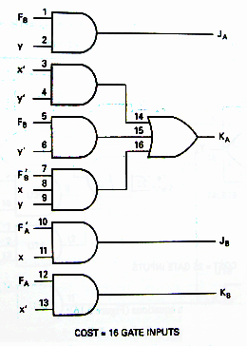
Excitation Realization Cost
J_{A}=F_{B}y
K_{A}=F_{B}’xy+x’y’+F_{B}y’
J_{B}=F_{A}’x
K_{B}=F_{A}x’

Slide 21
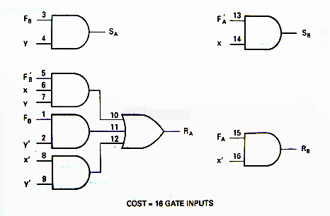
Excitation Realization Cost
S_{A}=F_{B}y
R_{A}=F_{B}’xy+x’y’+F_{B}y’
S_{B}=F_{A}’x
R_{B}=F_{A}x’

Slide 22
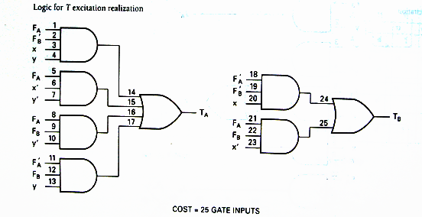
Excitation Realization Cost
T_{A}=F_{A}F_{B}’xy+F_{A}x’y’+F_{A}F_{B}y’+F_{A}’F_{B}y
T_{B}=F_{A}’F_{B}’x+F_{A}F_{B}x’

Slide 23
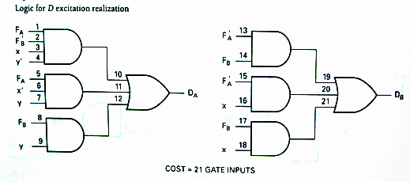
Excitation Realization Cost
D_{A}=F_{A}F_{B}’xy’+F_{A}x’y+F_{B}y
D_{B}=F_{A}’F_{B}+F_{A}’x+F_{B}x

Slide 24
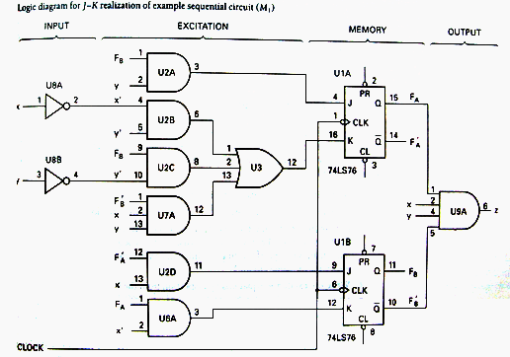
Z= F_{A}F_{B}’xy
Notes:
在本例中，激励实现的代价J-K和SR相对比D和T触发器要小。

Slide 25
Construction of State Diagrams
The most challenging part of sequential circuit synthesis is the development of a state diagram from a verbal or written problem statement.
Construction of a state diagram in sequential design is analogous to the construction of a truth table in combinational logic design.
Notes:
时序电路合成过程中，最具挑战性的部分就是从口头或书面的问题描述来形成状态图。
在时序设计中构造状态图类似于在组合逻辑设计中构造真值表。

Slide 26
Example 1 Synchronous Decade Counter
Create the state diagram for a synchronous decade counter. The counter is to count up or down, in binary, depending on the value of a mode control input signal. When the mode control input M=0, the counter is to count up; when M=1, the counter is to count down. The counter is to repeat or cycle; that is to count from 0 to 9 and then start over if M=0 or count down from 9 to 0 if M=1. The counter output y is to be a 1 if counting up and the terminal count is reached. Another output z is to be a 1 at the terminal count if counting down.
Notes:
例1：同步可逆十进制计数器 为同步可逆十进制计数器创建状态图。计数器根据模式控制输入信号的值以二进制的形式向上或向下计数。模式控制输入M=0时，计数器向上计数；M=1时，计数器向下计数。计数器可以重复或循环计数，如果向上计数且达到终止计数值，则计数器输出y为1。如果是向下计数且达到终止计数值，则另一个输出z为1。
分析： 状态个数：10（十进制）
状态转换控制：M=0向上计数，M=1向下计数
输出：y、z

Slide 27
Example 1 Synchronous Decade Counter
Solution:
10 states: 0..9
1 mode control, M=0/M=1，
output y, z
M'
M'
M'
M'
0
1
2
3
4
M/z
M
M
M
M'/y
M
M
M'
M
M
M
M
9
8
7
6
5
M'
M'
M'
M'
Notes:
分析： 状态个数：10（十进制）
状态转换控制：M=0向上计数，M=1向下计数
输出：y、z
Mealy机

Slide 28
Example 2-1 Sequence Detector
Construct a Mealy state diagram that will detect a serial input sequence of 10110. The detection of the required bit pattern can occur in a longer data string and the correct pattern can overlap with another pattern. When the input pattern has been detected, cause an output z to be asserted high.
For example, let the input string be
x = 10110110110
z = 00001001001
Notes:
构造一个可以检测出串行输入序列10110的Mealy状态图。对所规定的位模式的检测能出现在较长的数据串中。正确的模式也可以和另一种模式重叠。输入模式被检测出来后，引起输出z变为高电平。
例如：
对于输入串x = 10110110110
有 z = 00001001001

Slide 29
Example 2-1 Sequence Detector
0/0
0/0
1/0
“1”
“10”
A
B
C
1/0
0/0
Starting state，waiting the first 1
1/0
0/1
0/0
1/0
“1”
“10”
“101”
“10110”
E
D
e.g.：input 10110110110
state BCDECDECDEC
output 00001001001
1/0
“1011”

Slide 30
Example 2-2: Sequence Detector
Design a Mealy serial bit-pattern detector that will detect the input sequence 01010 in a longer bit string. If the pattern is detected, then cause output Q to be active-high. If an 011 bit pattern occurs within the same serial data string, cause output P to be active high. If the 011 pattern occurs, cause the state machine to initialize and start over looking for the 01010 pattern. Overlapping 01010 patterns can occur.
If X = 00110101011101010101 then output
Q = 00000000100000001010
P = 00010000001000000000
Notes:
设计一个可以检测较长位串中的输入序列01010的Mealy串行位模式检测器。如果该位模式被检测到，那么就使输出Q为高有效。如果模式011出现在同样的串行数据串中，使输出P为高态有效。如果模式011出现，则使状态机初始化且重新开始等待01010模式。允许出现重叠的01010模式。
例如：
对于输入串x = 00110101011101010101
有 Q= 00000000100000001010
P = 00010000001000000000

Slide 31
Example 2-2: Sequence Detector
1/P
“011”，resets to state A
0
1
“0”
“01”
“0”
“01”
A
B
C
0
1
e.g.：input 00110101011
state：A-B-C-A-B-C-D-E-D-E-A
output：P：0010000001
Q：0000000100
0
1/P
0
“011”，resets to state A
“010”
“01”
“0101”
D
E
1
0/Q
“01010”

Slide 32
Synchronous Counter’s Design
The design procedure for a binary counter is the same as any other synchronous sequential circuit.
The primary inputs of the circuit are the CLK and any control signals (EN, Load, etc).
The primary outputs are the FF outputs (present state).
Most efficient implementations usually use T-FFs or JK-FFs. We will examine JK and D flip-flop designs.
Notes:
二进制计数器的设计与任何时序逻辑电路的设计方式相同。
主要输入包括时钟、控制信号（如使能信号，Load信号等）
主要输出是触发器的输出（现态）
一般来说，多用JK或者T触发器来设计实现。接下来，我们将讨论JK和D触发器的实现方式

Slide 33
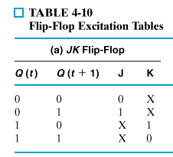
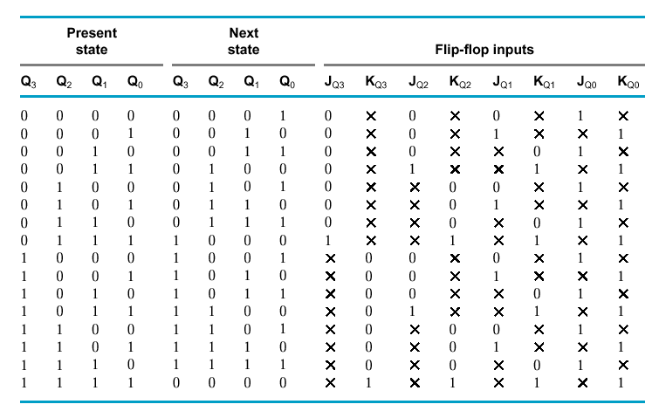

J-K Flip Flop Design of a 4-bit Binary Up Counter
Notes:
用JK触发器实现
Step1:确定输入变量、输出变量；
Step2:确定触发器个数
状态个数:16->需要触发器:4;
Step3:确定触发器类型：JK触发器；
Step4:列出转换表；
Step5:列出激励表；
Step6:写出激励方程，输出方程；
Step7:画出逻辑图。

Slide 34
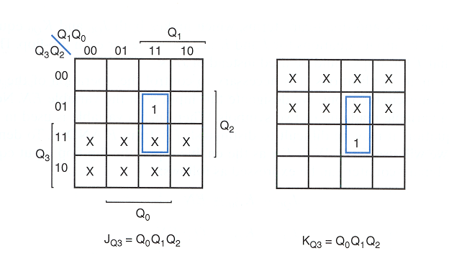

Slide 35
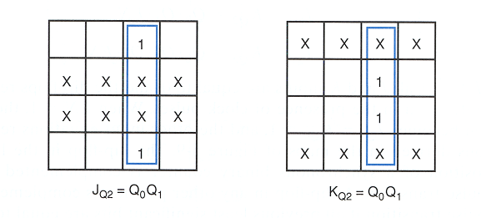

Slide 36
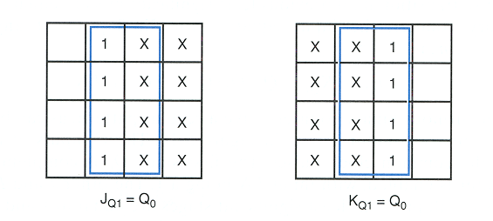

Slide 37
J-K Flip Flop Design of a 4-bit Binary Up Counter
J_{Q0} = 1
K_{Q0} = 1
J_{Q1} = Q₀
K_{Q1} = Q₀
J_{Q2} = Q₀ Q₁
K_{Q2} = Q₀ Q₁
J_{Q3} = Q₀ Q₁ Q₂
K_{Q3} = Q₀ Q₁ Q₂

Slide 38
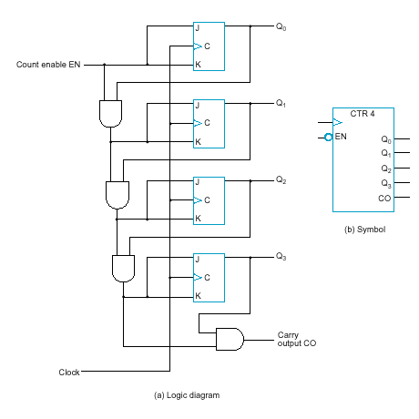
J-K Flip Flop Design of a Binary Up Counter with EN and CO
EN = enable control signal.
0: counter remains in the same state,
1: it counts
CO = carry output signal, used to extend the counter to more stages
J_{Q0} = 1 · EN
K_{Q0} = 1 · EN
J_{Q1} = Q₀ · EN
K_{Q1} = Q₀ · EN
J_{Q2} = Q₀ Q₁ · EN
K_{Q2} = Q₀ Q₁ · EN
J_{Q3} = Q₀ Q₁ Q₂ · EN
K_{Q3} = Q₀ Q₁ Q₂ · EN
CO = Q₀ Q₁ Q₂ Q₃ · EN

Slide 39
Synchronous binary counters using D flip-flops
D_{Q0} = Q₀ ⊗ EN
D_{Q1} = Q₁ ⊗ ( Q0 · EN)
D_{Q2} = Q₂ ⊗ ( Q0 Q1 · EN )
D_{Q3} = Q₃ ⊗ ( Q0 Q1 Q2 · EN )
CO = Q₀ Q₁ Q₂ Q₃ · EN
JK-based design calls for 4 AND gates
D-based design calls for 4 AND and 4 XOR gates
JK-FF equations
Notes:
思考异或运算的特色
此处等价于保持（Q0），或者翻转（Q’）。

Slide 40
Up-Down Binary Counter
EXERCISE
Finish the design.
Design a BCD Decade counter.
UD Q2 Q1 Q0 Q2 Q1 Q0
UD Q2 Q1 Q0 Q2 Q1 Q0
0 0 0 0 0 0 1
0 0 0 1 0 1 0
0 0 1 0 0 1 1
0 0 1 1 1 0 0
0 1 0 0 1 0 1
0 1 0 1 1 1 0
0 1 1 0 1 1 1
0 1 1 1 0 0 0
1 0 0 0 1 1 1
1 0 0 1 0 0 0
1 0 1 0 0 0 1
1 0 1 1 0 1 0
1 1 0 0 0 1 1
1 1 0 1 1 0 0
1 1 1 0 1 0 1
1 1 1 1 1 1 0
Up-Counter
Down-Counter
Notes:
注：设计BCD Decade counter时，如果按照卡诺图化到最简，则K3和J3可以是不同表达式。会与书上实例有所区别。
J3=Q2Q1Q0，K3=Q0。

Slide 41
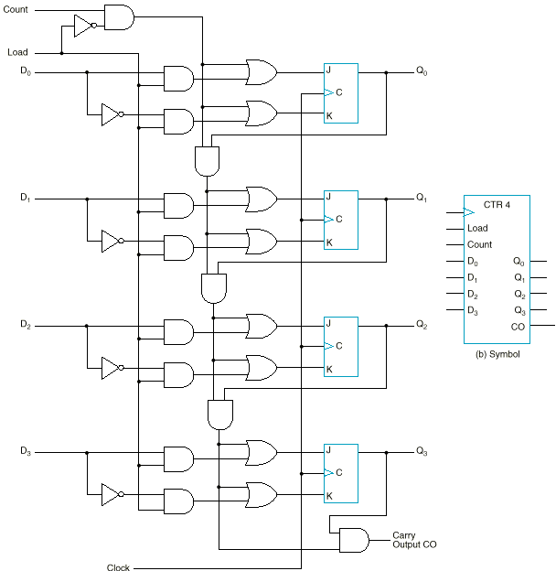
Binary Counter with Parallel Load
a 4-bit synchronous binary counter with parallel load capability
Load | Count | Operation
0 | 0 | Nothing
0 | 1 | Count
1 | X | Load

Slide 42
Arbitrary Sequence Counter 任意序列计数器
Given an arbitrary sequence, design a counter that will generate this sequence.
Procedure:
Derive state table/diagram based on give sequence
Simplify (using K-maps, etc)
Draw logic diagram
Notes:
对任意序列，设计一个计数器来产生这个序列。
过程
根据序列生成状态表/状态图
化简（如：用卡诺图）
绘制逻辑图

Slide 43
Example 1
Use D-FFs to draw the logic diagram for sequence generator (counter) for: 0 → 7 → 6 → 1 → 0
000 → 111 → 110 → 001 → 000
Notes:
示例：使用D触发器来产生一个序列 0 → 7 → 6 → 1 → 0 (000 → 111 → 110 → 001 → 000) 序列结束时，输出z=1。
所示表格为激励表

Slide 44
Example 1
D₃=Q₃’Q₁’+Q₃Q₁
D₂=Q₃’Q₁’+Q₃Q₁
D₁=Q₁’
Z= Q₃’Q₁
D₃ K-Map
D₂ K-Map
D₁ K-Map
Z K-Map

Slide 45
Example 1
D₃=Q₃’Q₁’+Q₃Q₁
D₂=Q₃’Q₁’+Q₃Q₁
D₁=Q₁’
Z= Q₃’Q₁
0 → 7 → 6 → 1 → 0

Slide 46
Example 1

Slide 47
HOMEWORK
1. Design a modulu-13 binary counter.
1) asynchronous
2) synchronous
2. Design a synchronous counter to produce the 3-bit gray code sequences: 000,001,011,010,110,111,101,100,000…

